Slide 1
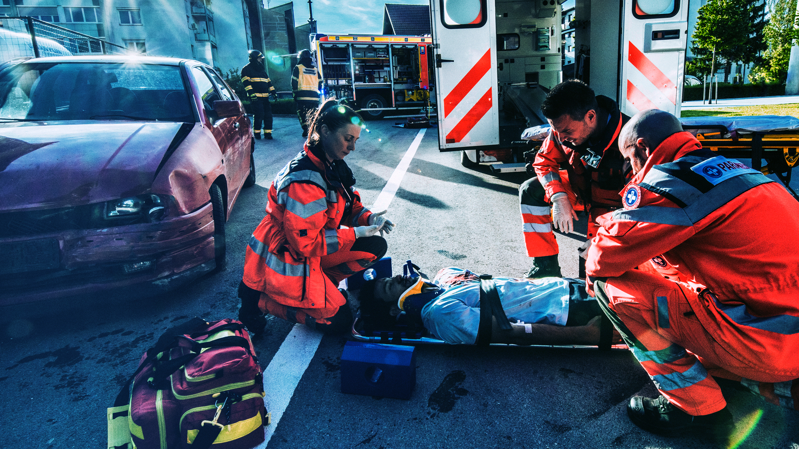

No Way Back
A Driving Skills Program
How one mistake behind the wheel can change your life forever...
Notes:
This presentation is for teachers, trainers, advisors and others to educate themselves, novice drivers and teens.

Slide 2

Brain Injury is unpredictable and so are its consequences.
It can affect who we are, the way we think, act and feel.
It can change everything about us in a matter of seconds…
2
Notes:
Brain injury can be fatal, but it can also result from what appears to be a “minor” blow to the head.
(Can reference actress Natasha Richardson) Brain injury has life long consequences and there is No Way Back to your normal state.
Ask audience if they know anyone with traumatic brain injury. Briefly discuss.
Additional Notes:
The brain, with its intricate connections to every part of your body, enables you to direct your life toward a future of choices; what you do for fun, who your friends are, and what you will become. But in a micro-flash, less than one second, the forces encountered in an automobile crash have the potential to dramatically change or erase all of your choices and everything you defined for your future.
What is this “entity,” the brain? First and foremost, the mechanisms of the brain link and coordinate the major systems, their organs and cells in an intelligently orchestrated symphony of life.* So, an injury to this system, particularly the brain, can interfere and disrupt our worlds as we know it. But before we talk about traumatic brain injury (TBI), let’s talk briefly about what our brains control.
In short, different parts of the brain, the “master switch,” serve different purposes. The most primitive part of the brain controls the functions we need to survive. This autonomic nervous system controls the ability to make your heart beat, your lungs to take in air, and your intestines digest without conscious awareness.
Other regions of the brain within the cerebral cortex help us navigate the world around us through our senses. These very sophisticated areas receive information that enable us to respond safely in our environment:
•We hear our school band play, and we feel pride…
•We eat a hamburger and fries and we feel happy…
•We see an angry mob; we run…
•We hear railroad signals, and know to stop.
And yet another area of the brain, the most evolved system of any species, is the frontal cortex which gives us the ability to decide and plan for the future, to make changes, and to exert control over our lives. (i.e. friends, colleagues)
If you are involved in an automobile crash and incur a severe injury to your brain, there is a high likelihood that you could lose control of your life and the future you had planned. In a car crash, extreme forces exerted on your body and brain can have many outcomes, as you will learn from the stories you are about to hear. These four young people who experienced and survived auto crashes now live with the consequences of a traumatic brain injury. Now let’s watch “No Way Back…”
*Reference: Candace Pert, “Molecules of Emotion,” p. 185

Slide 3
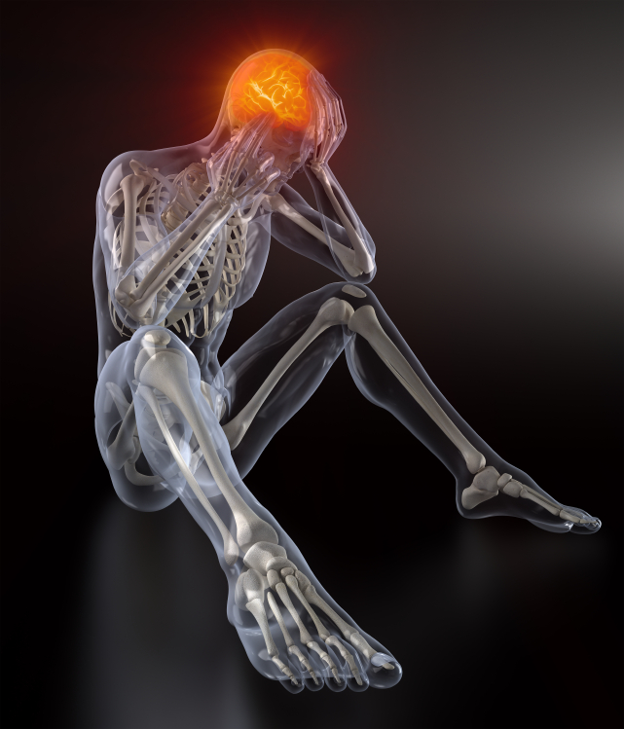
What is
Traumatic
Brain Injury?
TBI is a blow or jolt to the head that disrupts the function of the brain.
--Brain Injury Association
Notes:
A traumatic brain injury (TBI) is defined as a blow or jolt to the head or a penetrating head injury that disrupts the function of the brain. Brain injury is unpredictable and its consequences affects who we are, the way we think, act, and feel. It can change everything about us in a matter of seconds. The most important things to remember are:
•No two brain injuries are exactly the same.
•The effects of a brain injury are complex and vary greatly from person to person.
•The effects of a brain injury depend on such factors as cause, location, and severity.
When a brain injury occurs, the functions of the neurons, nerve tracts, or sections of the brain can be affected. If the neurons and nerve tracts are affected, they can have difficulty carrying the messages that tell the brain what to do. Brain injury can also change the complex internal functions of the body, such as regulating body temperature; blood pressure; bowel and bladder control. These changes can be temporary or permanent. They may cause impairment or a complete inability to perform a function.

Slide 4
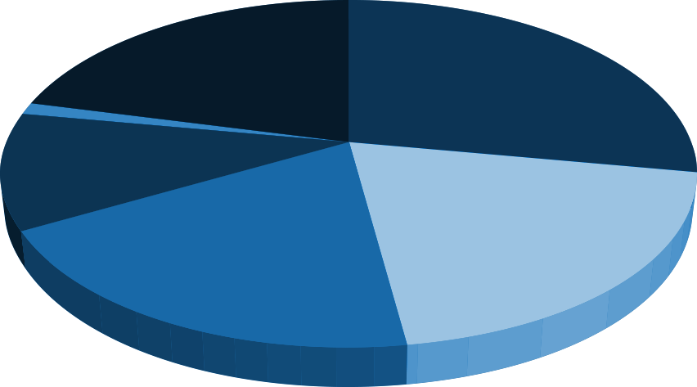
Traumatic Injuries
Major Causes of Traumatic Brain Injury
Other
21%
Falls
28%
Suicide
1%
11%
Assault
20%
20%
Motor Vehicle Crashes
Struck by…
(incl. Sports)
Source: National Center for Injury Prevention and control, CDC
4
Notes:
Among all age groups, falls are the leading cause and make up 28%
Motor vehicle crashed are the second leading cause of traumatic brain injuries which make up 20%
Struck by/against events, which include colliding with a moving or stationary objects make up 19%
Assault's, firearm related make up 11%
Other total 21% - (Pedal cycle make up 3% , transport 2%, Unknown 16% )
Suicide make up 1%
Source CDC.com

Slide 5
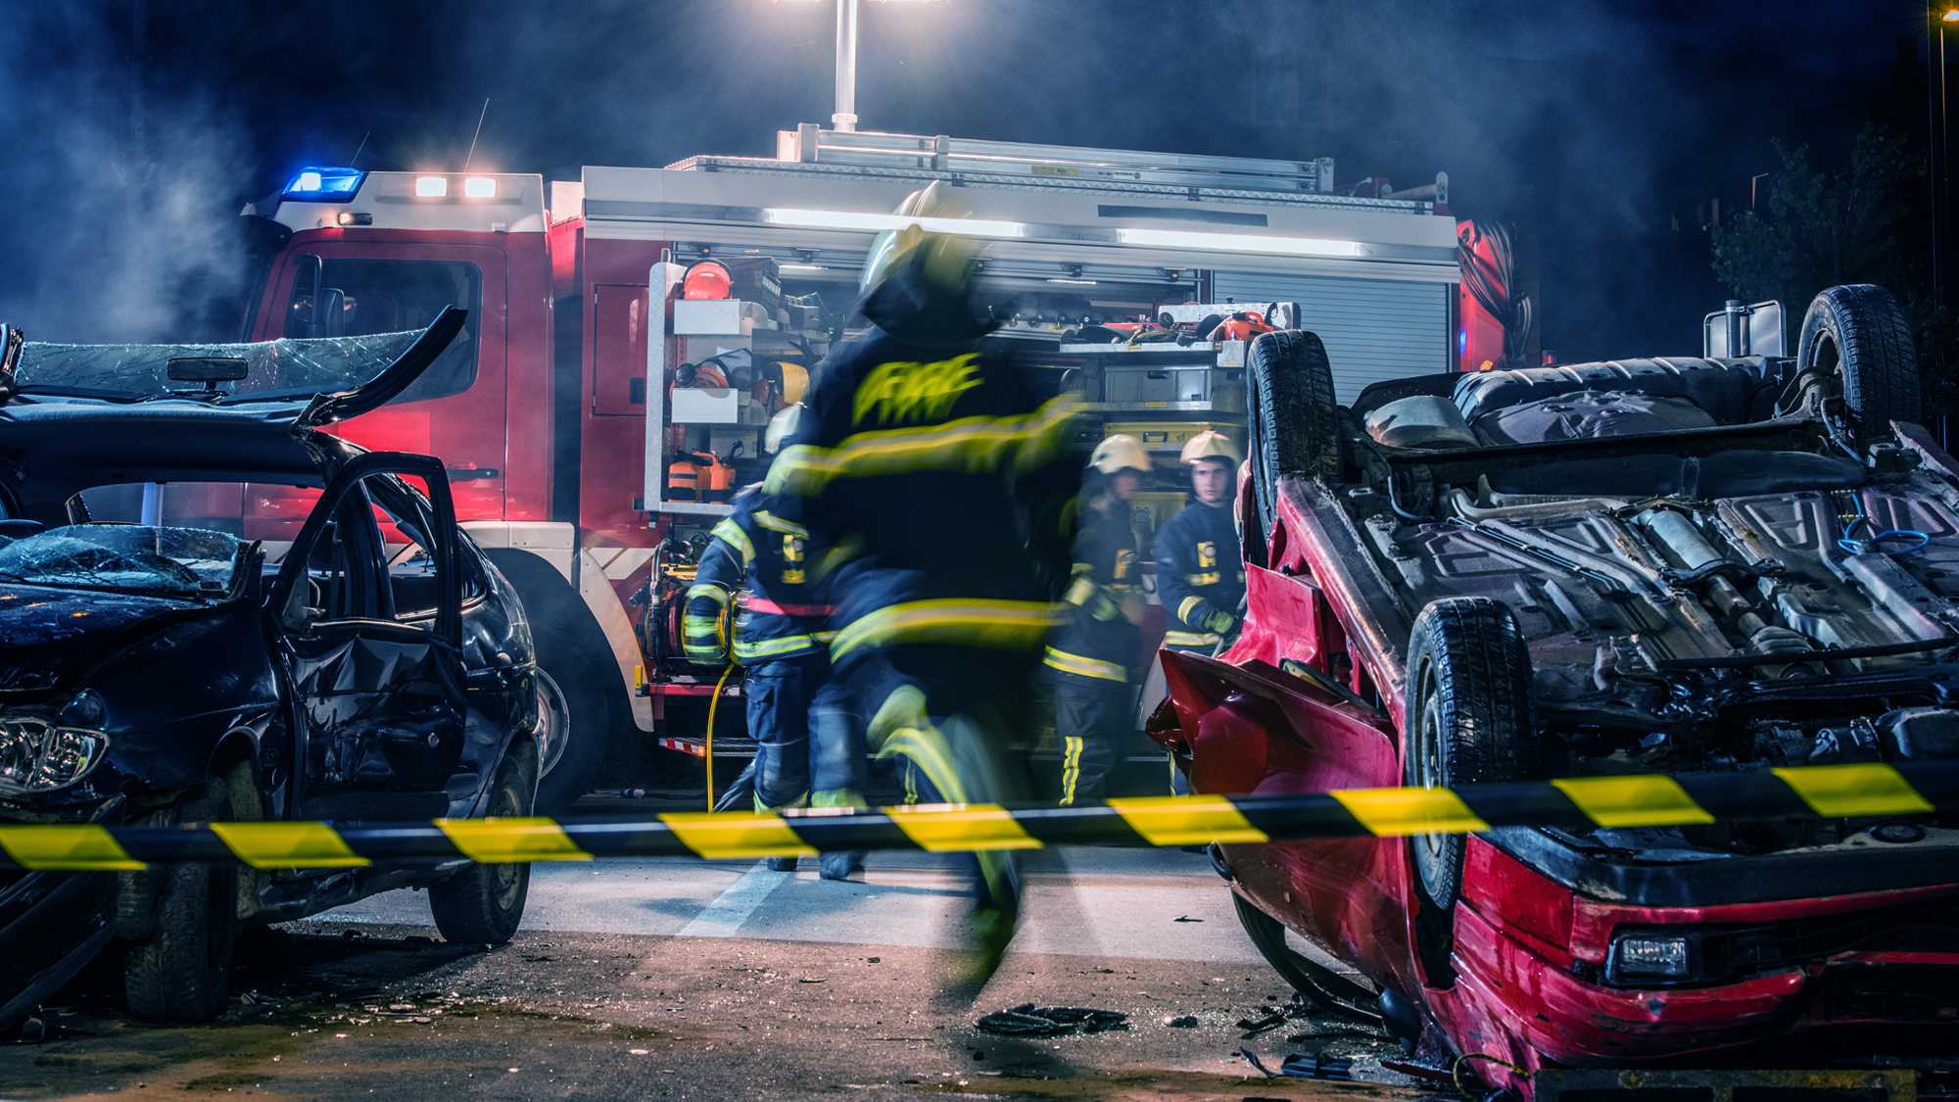
Motor Vehicle Traffic Crashes Make Up 20% of TBI Cases
5
Notes:
TBI is a serious public health problem in the United States. Each year, traumatic brain injuries contribute to a substantial number of deaths and cases of permanent disability. Recent data shows that, on average, approximately 1.4 million people sustain a traumatic brain injury annually. (CDC)

Slide 6
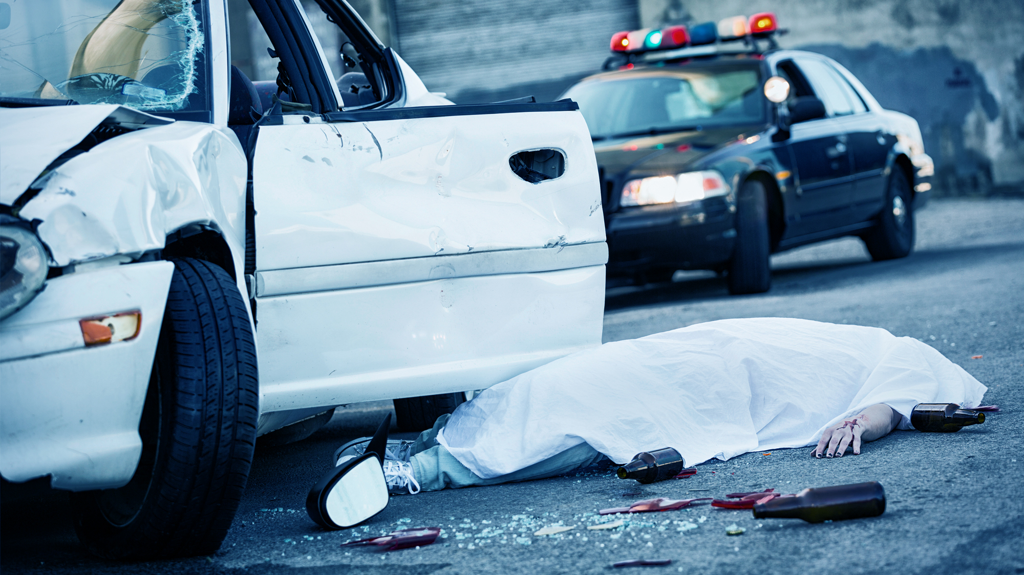
Motor vehicle crashes are the leading cause of death for teens in the U.S.
6
Notes:
Each year, more than 5,000 teens (ages 16-19) are killed in passenger vehicle crashes
Young people age 15-20 make up 6.7 percent of the total driving population in this country but are involved in 14 percent of all fatal crashes. In the last decade, over 68,000 teens have died in car crashes.
Additional Notes:
Teen Drivers
Motor vehicle crashes are the leading cause of death for teens in the U.S. The risk of motor vehicle crashes is higher among 16 to 19 year olds than among any other age group. In fact, per mile driven, teen drivers ages 16 to 19 are four times more likely to crash.
Among teen drivers, those at especially high risk for motor vehicle crashes are:
•Males,
•Teens driving with teen passengers, and
•Newly licensed teens.

Slide 7



Who is most at risk for TBI?
Males are about 1.5 times as likely as females to sustain a TBI
* Source – Centers for Disease Control & Prevention
7
Notes:
The two age groups at highest risk for TBI, are 15 to 19 year olds. Two out of three teenagers killed in motor vehicle crashes are males. Boys are more likely to be in a crash and sustain a TBI because of:
The competitive nature of males
Their willingness to take chances and engage in high-risk activities

Slide 8

Did you know…
Even bright, mature teenagers
sometimes do irresponsible things
But it’s not entirely their fault
The brain doesn’t finish
developing until the mid 20’s
8
Notes:
Have you noticed this behavior in the teenagers you know? What are some of the behaviors you have seen that can identify with this fact?

Slide 9

The Frontal Lobe
It is used for:
decision making
problem solving
understanding
consequences of actions
9
Notes:
Ask the group to notice the location of the frontal lobe. What does this tell you? This is the area most likely to get hit first in even the most minor car crash.

Slide 10
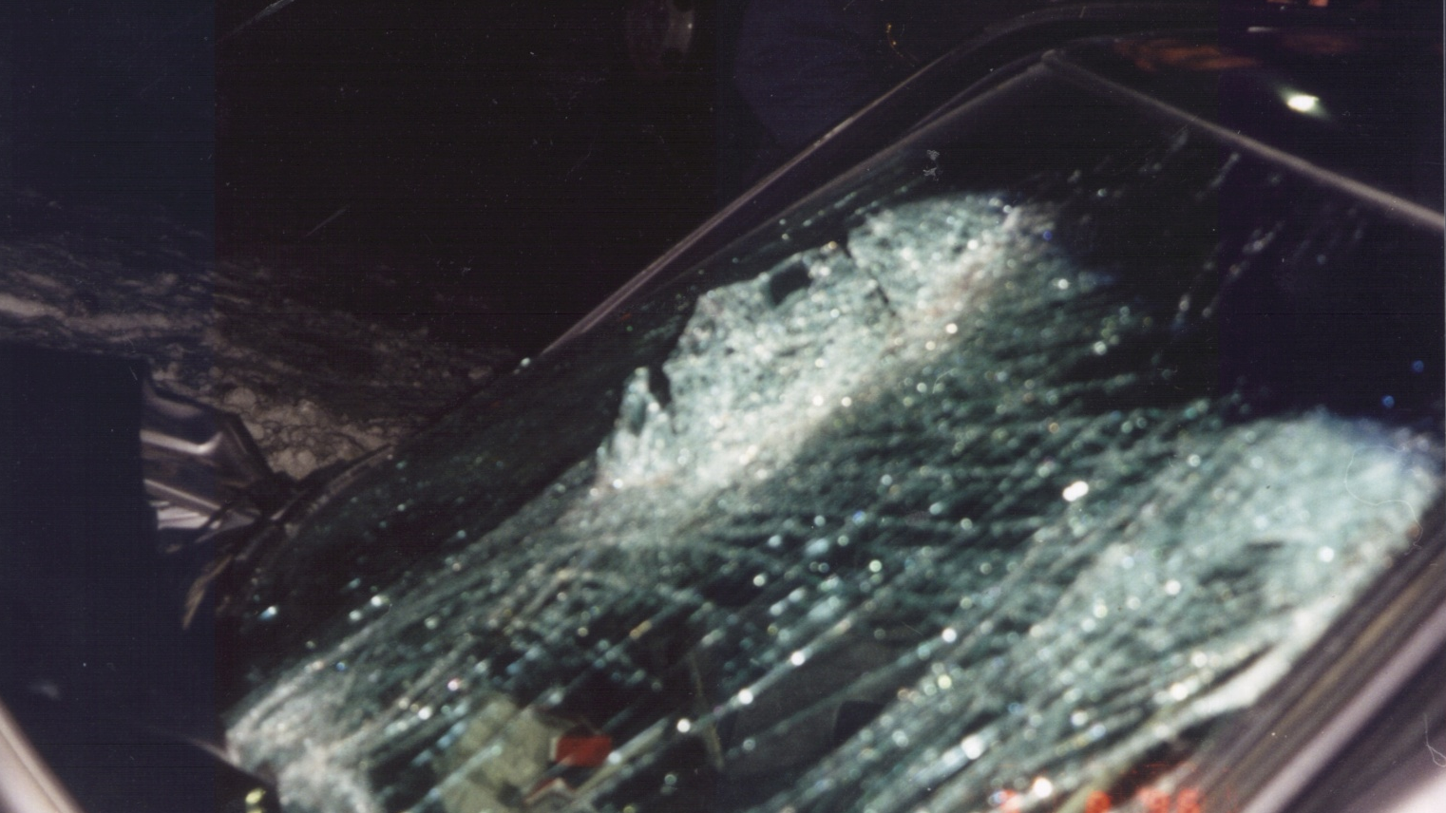
10
Notes:
This is a photo of a person thrown from the passenger side of the car. Notice what part of the body is through the windshield. This person survived but the consequences are lifelong.

Slide 11
Demonstration
Pink Black Orange
Blue Yellow Blue
Red Orange Black
Yellow Red Yellow
Black Blue Green
Orange Red Orange
Yellow Black Yellow
11
Notes:
Select a partner. Time how long it takes to say the words aloud.

Slide 12
Demonstration
Pink Black Orange
Blue Yellow Blue
Red Orange Black
Yellow Red Yellow
Black Blue Green
Orange Red Orange
Yellow Black Yellow
12
Notes:
Next, time how long it takes to say aloud the color of each word. The delay in your response demonstrates the deficits that a TBI patient experiences.

Slide 13

Speeding
David
_{Age 23}
_{Addicted to speeding}
Repeatedly warned by his mother to slow down
13
Notes:
Questions to ask the audience:
Do you know anyone like David?
Do you listen to your mom / Parents? Why or why not?
Are their people you are willing to listen to and why?
David, addicted to speed, cranked up the music as he was driving home in a good mood, anticipating the night ahead. Driving at 90 mph, he veered off the road and, unable to recover, his car flipped over 5 times within 1/8 of a mile. He had to be airlifted to the nearest hospital. His mother had warned him three weeks earlier to slow down.
Additional Questions:
1. You are driving fast. Suddenly, you feel the vehicle start to pull off the roadway. What are your options?
2. If your vehicle goes on to the shoulder, what action should you take?
3. How do you feel about speeding?
Answers:
1. First, NEVER drive fast. Steer away from the road for a clear targeting path. Brake lightly to stop.
2. Turn towards the road using the off-road recovery method. No braking until you are back on the solid pavement.
3. Discuss dangers of speeding and GDL law in your state.

Slide 14


David
14
Notes:
Running Time: 5:10
He had an “urge” to speed.
There was a speaker box in the back of car and he had the seats folded down. (distraction)
He had to learn how to walk, swallow and tie shoes.
His crash had an effect on his entire family his mother, father, sisters and grandparents.
“He finally had an epiphany and realized he can die.”

Slide 15
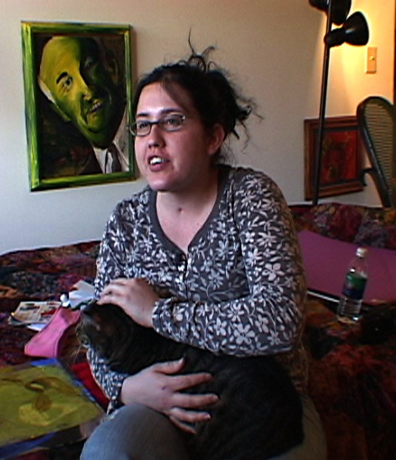
Tailgating
Adora
_{Age 18}
_{Never took driver education}
_{Licensed 1 month}
Notes:
Questions to ask the audience:
Is driver education important? How could it have helped Adora?
How many of you attend(ed) driver’s ed or a commercial driving school?
Discuss other alternatives?
• She did not take driver ed and had her license for one month.
• “Losing the one thing that is dear to you.” She lost her voice and had to learn how to speak all over again.
• It took years before she was able to go from the wheel chair to the walker and from the walker to walking.
• “Homework prepares you to learn, practice teaches you to drive.”
• “I didn't know how crucial it (practice) was.”

Slide 16

Adora
16
Notes:
Running Time: 4:37
Tailgating
Adora had her driver license for one month before her crash. She never took driver education or received supervised practice. She was tailgating a truck on a two-way highway, when it suddenly braked. In an attempt to avoid crashing, she swerved to the left, where she was hit full force by an oncoming truck from the opposite direction.
Questions:
1. What distance is acceptable for following space?
2. What is the best way to learn how to measure distance to the car ahead?
3. How many seconds should there be for following distance?
Answers:
1. You should be able to see the tires of the vehicle in front of you touching the pavement.
2. Decide how many seconds you are away. When the back of the car passes a marker, such as a pole, count 1001, 1002 etc. until the front of your vehicle reaches the marker pole.
3. Having less than 4 seconds of following distance will make an evasive action more needed and more difficult. To avoid evasive steering in reaction to the vehicle ahead, give yourself four seconds to survive!

Slide 17
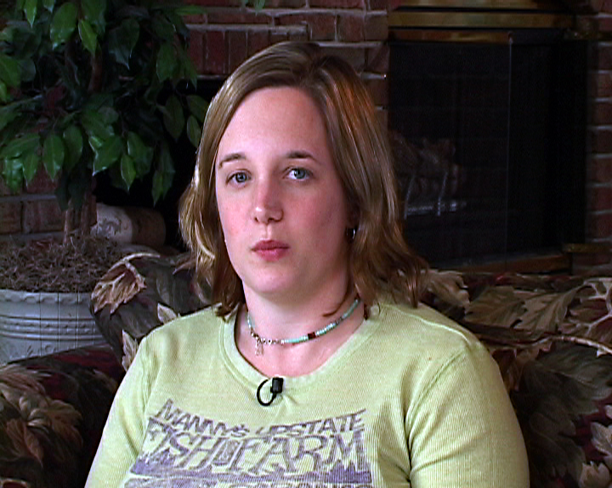
Poor Time Management
Kelley
Age 24
Never took driver ed
Road known for crashes
Weather conditions / rainy
17
Notes:
Do you drive or someone you know drive in problem areas? (dimly lit, no signage etc.)
What should you do when driving in foul weather?
SLOW DOWN
Use extra care when driving across bridges and overpasses, as these surfaces tend to be especially slippery.
Be sure there is good visibility.
Avoid sudden movements with the steering wheel, brake or accelerator when driving in potentially slippery conditions. If the vehicle does skid, ease off the gas, steer slightly into the skid and look at where you want the vehicle to go.
As in all driving conditions, refrain from talking on a cell phone when driving.
6. Always keep your vehicle's windows and lights cleaned. Clear ice and snow from all glass surfaces of the vehicle before even

Slide 18
Kelley
18
Notes:
Running Time: 4:22
Time Management/Poor Judgment
The weather was rainy and dreary as Kelley, in a rush, attempted to exit a shopping mall parking lot by making a left turn onto a two-lane highway. At the same time, a van was making a right turn to enter the parking lot. Kelley, unable to see behind the van, misjudged traffic and was hit by an oncoming truck driving alongside the turning van.
Questions:
Where should you look before entering an intersection?
Where should the driver look before making a left turn?
You are driving out of a parking lot and turning right as you enter a street and a vehicle is approaching from your left. What do you do?
Answers:
1. Search far into the intersection to the target area. Search left, front, right and repeat before entering the intersection.
2. Always look at the farthest point into the intersection and to the target area. Wait for clearance before proceeding into the intersection.
3. Stop and wait for the vehicle to pass before turning onto the street. If you were turning left, you have to yield to vehicles from both directions and wait to see if any other vehicles are behind it.

Slide 19

Line of Sight / Path of Travel
Amy
Age 17
“Just” a passenger
Driver couldn’t see around curve
Driver was inattentive / talking
19
Notes:
Discuss steps to driving around curves.
determine the safe speed for the curve.
Slow down to a safe speed for the curve.
In a blind curve where you cannot see all the way around it, drive more slowly in case oncoming traffic wanders into your lane or the curve is tighter than you expected.
Discuss the dangers of distraction.
recognize the activities that distract you such as eating, conversing on the phone, or changing a CD and begin to eliminate them.
Know your route in advance and make sure that you have a good understanding of your directions.
Check weather and road conditions.

Slide 20
Amy
20
Notes:
Running Time: 4:18
Line of Sight/Path of Travel
Amy was injured in a rollover crash when her mother, who failed to slow down while approaching an upward curve on the freeway, had to abruptly swerve in an attempt to avoid backed up traffic from a crash ahead.
Questions:
1. What do you do when approaching curves and hillcrests?
2. What steps do you take while driving around a curve?
3. What are the dangers of talking while driving?
Answers:
1. Keep 4 seconds of road visible. When you have less than 4 seconds, brake before going into the curve.
2. Slow down before the start of the curve to avoid braking in the curve. While in the curve, keep your speed steady and slow enough so that objects and people are not pushed from the force of turning on the curve. Near the end of the curve, begin accelerating to return to normal speed.
3. Talking requires attention. Your brain must monitor the topic and content, coordinate turns and so on. Talking can divert attention from a driving task which creates a form of impairment.

Slide 21

What can we do?
21
Notes:
Ask audience:
What can we do? Discuss.

Slide 22
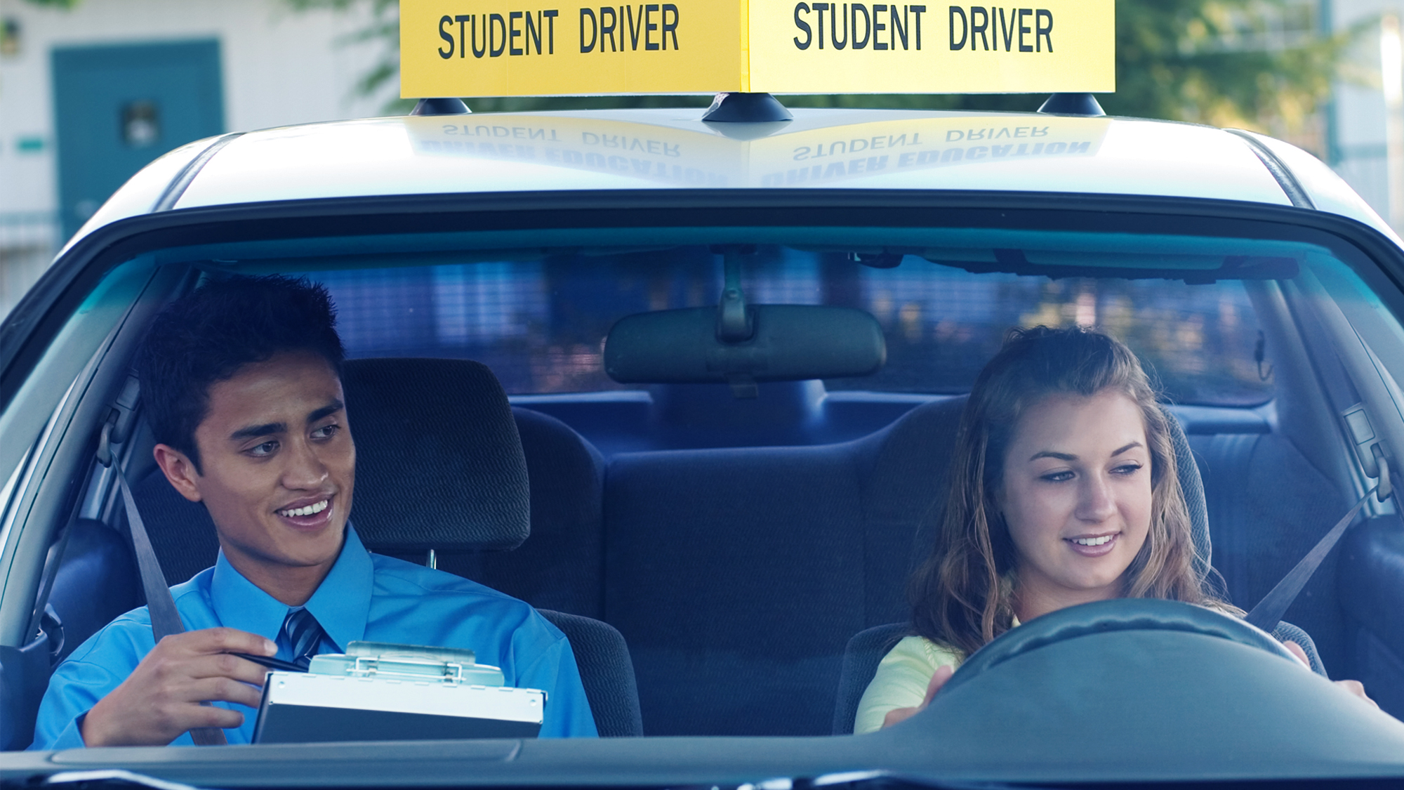
Prevention and Education Are Key
22
Notes:
Buckle up and all passengers should buckle up
Keep your eyes on the road.
Don't drink and drive, and don't ride with anyone who has been drinking.
Do not drive sleep-deprived.
Do not tailgate and steer clear of erratic drivers.
When passing another car, get past the driver’s blind spot as quickly and safely as possible.
Leave a four second space between you and the car ahead. If you are transporting children, make sure that they are all properly buckled up and that you items to keep them occupied, such as books on tape or soft toys.
Do not multi-task or drive aggressively on the road.
Understand that driving is not your “down time” or a time to catch up on phone calls, texting or checking your iphone
Do not take the time for personal grooming
Be prepared for the unpredictability of others.
CONCENTRATE on your driving. Make sure that you are not upset or tired when getting on the road.
PULL OVER if you need to do something that will take your eyes and/or mind off the road.

Slide 23

Education!
Driver education is CRITICAL!
Graduated Driver Licensing (GDL) laws have been proven effective at reducing teen crashes.
Driver education works better when it is coupled with GDL laws.
23
Notes:
Discuss the importance of driver education. Discuss GDL Laws in your state.
There are 3 stages to a graduated system:
a supervised learner's period;
an intermediate license (after passing the driver test) that limits driving in high-risk situations except under supervision;
and then a license with full privileges, available after completing the first 2 stages.
https://www.ghsa.org/state-laws/issues/teen%20and%20novice%20drivers
Additional Notes:
Driver Education and Obeying the Law is Important
Modern communications tools such as home video and interactive computer learning materials can supplant or augment classroom training prior to behind the wheel practice.
Training programs and materials should not focus on how to pass the test, but rather how to incorporate the appropriate skills, attitude and behavior to be a safe, successful driver.¹
Graduated Driver Licensing (GDL) laws are one approach that’s been proven effective at reducing teen crashes. Research suggests that the most comprehensive GDL programs are associated with reductions of 38% and 40% in fatal and injury crashes, respectively, among 16-year-old drivers. ²
Driver education works better when it is coupled with GDL laws and high school driver education. Programs can be adapted to fit well within the graduated driver licensing system.
To find out what the GDL laws are in your state, visit the Insurance Institute for Highway Safety’s (IIHS) website at:
http://www.iihs.org/laws/gdl_full.aspx
Source: 1 ) www.nhtsa.gov 2 ) www.cdc. gov

Slide 24

Don't drive like you own the road.
Drive like you own the car.
24
Notes:
75 percent of all people who are ejected from a vehicle die.
Using a cell phone, eating, reading and any other behavior that takes your eyes off the road can distract you and lead to a crash. Keep in mind that a distracted driver might also be near you, so drive cautiously.
Call parents or friends to take you home if you need a ride.
Sleep is not a matter of willpower. It is a biological need. If you become drowsy, pull off the road at a safe spot and get some rest. Better yet, you should designate a driver!
Let a tailgater pass you.
There are 8 blind spots while driving: 2 in the front of the car, 2 on each side, and 2 in the rear of the vehicle.
A small amount of water can disable a vehicle in seconds.

Slide 25

Prevention
Other Vehicles
Wear protective and reflective gear
Keep your headlight on whenever you ride -even during the day
Avoid riding in other vehicles’ blind spots;
Don’t split lanes
Avoid riding at night
25
Notes:
Since 28% of head injuries are from falls, which include bicycle and motorcycle crashes, wearing a helmet is VERY important.

Slide 26

Remember… Jst Drv!
Keep Your Eyes
on the road
Hands
on the wheel
Mind
on driving
26
Notes:
Resources:
Brain Injury Association of America
www.biausa.org
800-444-6443
Center for Disease Control and Prevention
www.cdc.gov
800-311-9244
Health Resources and Services Administration
www.dvbic.gov
301-443-3376
National Association of State Head Injury Administrators
www.nashia.org
301-656-3500
National Center for Medical Rehabilitation Research
www.nichd.nih.gov/about/ncmrr
800-370-2943
National Institute on Disability and Rehabilitation Research
www.ed.gov/about/offices/list/osers/nidrr
202-245-7640
National Institute of Neurological Disorders and Stroke
www.ninds.nih.gov
800-352-9424
North American Brain Injury Society
www.nabis.org
703-960-6500
Social Security Administration
www.ssa.gov
800-772-1213

Slide 27
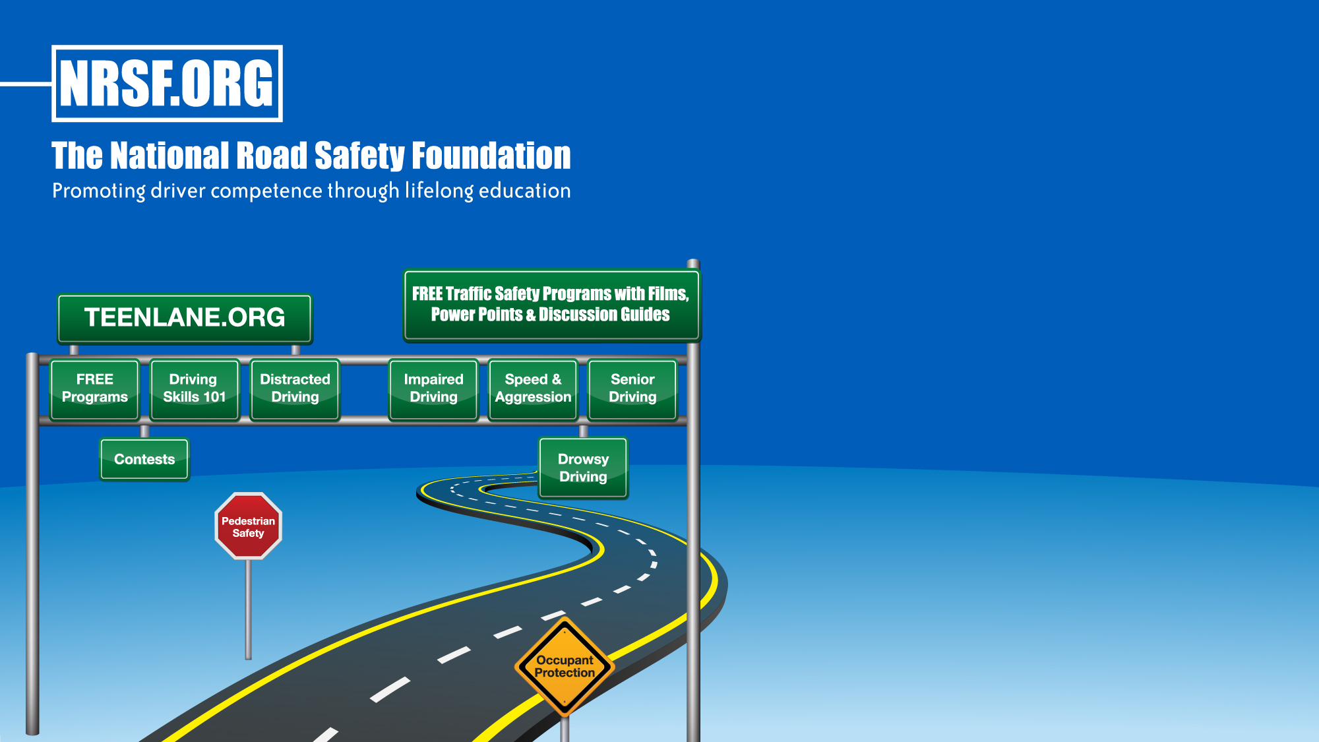




Free Safe Driving Resources
18 East 50th Street
New York, NY 10022
866-SAFEPATH (723-3728)
info@nrsf.org
www.nrsf.org • www.teenlane.org
@NRSForg
@NRSForg
@NRSForg
nationalroadsafety

