Slide 1


Generation tXt
A Distracted Driving Program
Notes:
Let your audience know what the presentation is about and what they can expect from it.

Slide 2

A Program for Teens
Inspired by Teens
1
Short
2
Funny
Comedy
3
Musical
Notes:
Explain to the audience that a focus group done by The National Road Safety Foundation was conducted with students of SADD (Students Against Destructive Decisions) and the NOYS Student Leadership group. (National Organizations for Youth Safety) The following bullets were taken from the focus group as the most popular items for an effective program directed toward teens.

Slide 3
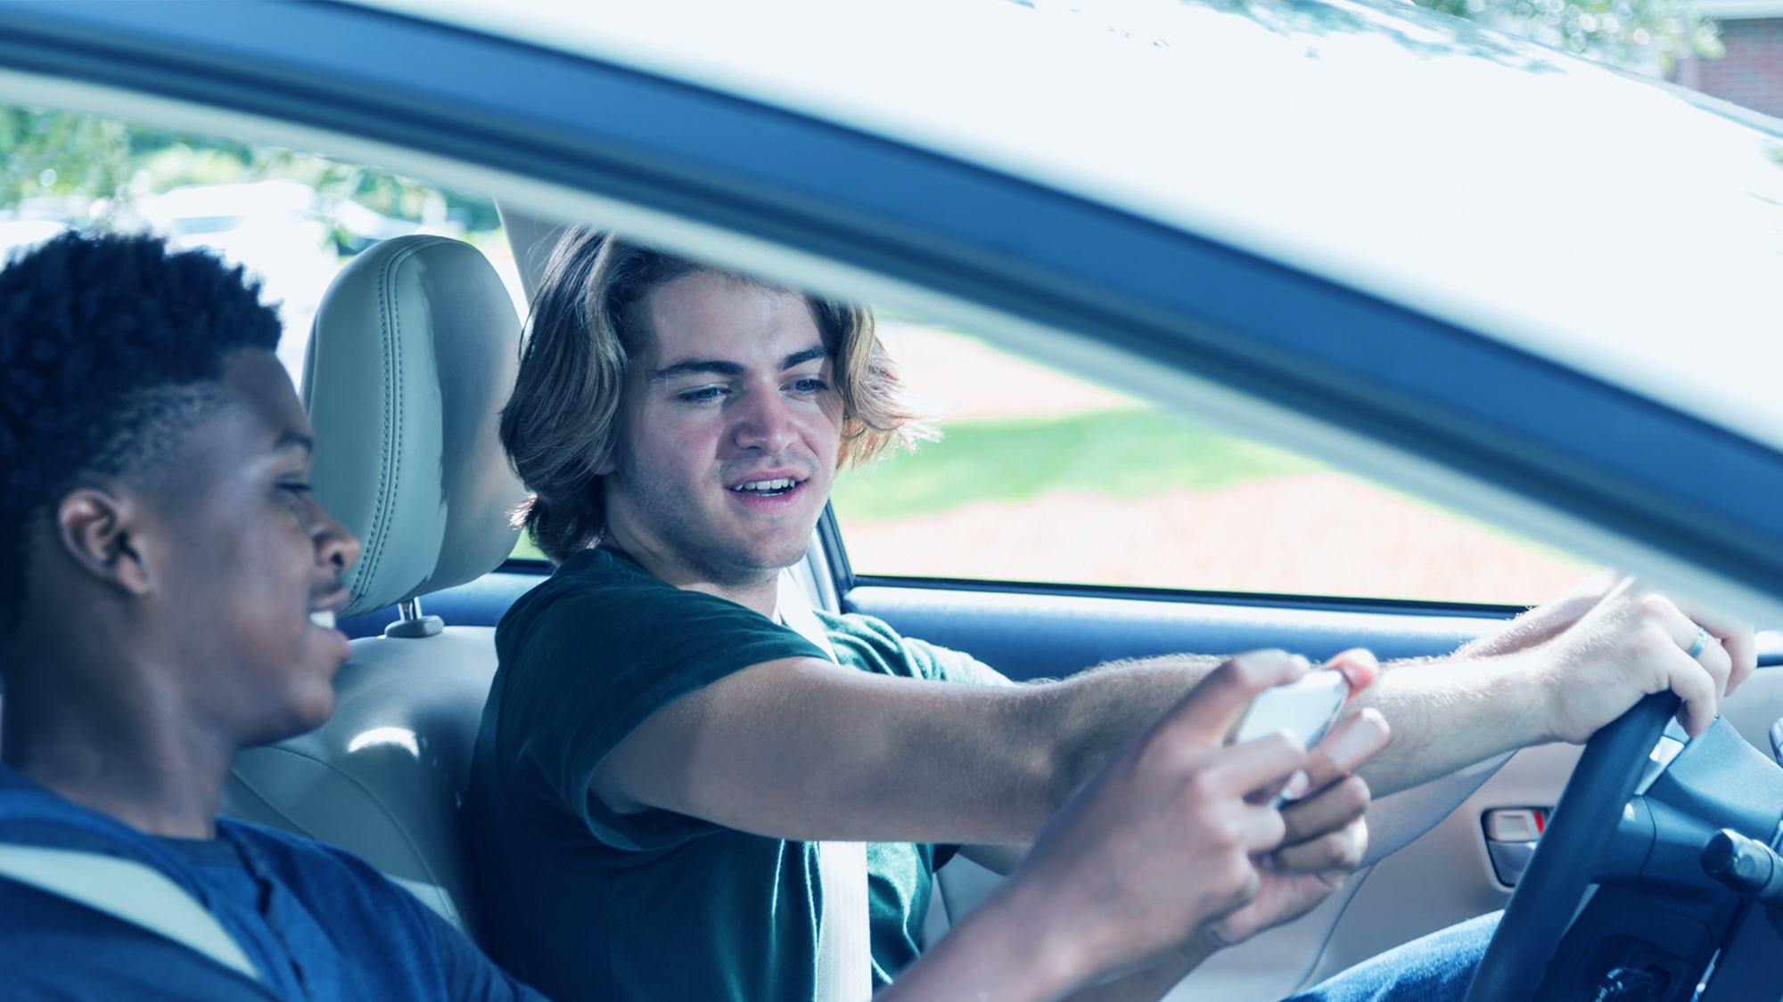
What is Distracted Driving?
Notes:
Ask your audience what they think distracted driving is. Most answers will be talking and texting on cell phones, but it is more than that.

Slide 4
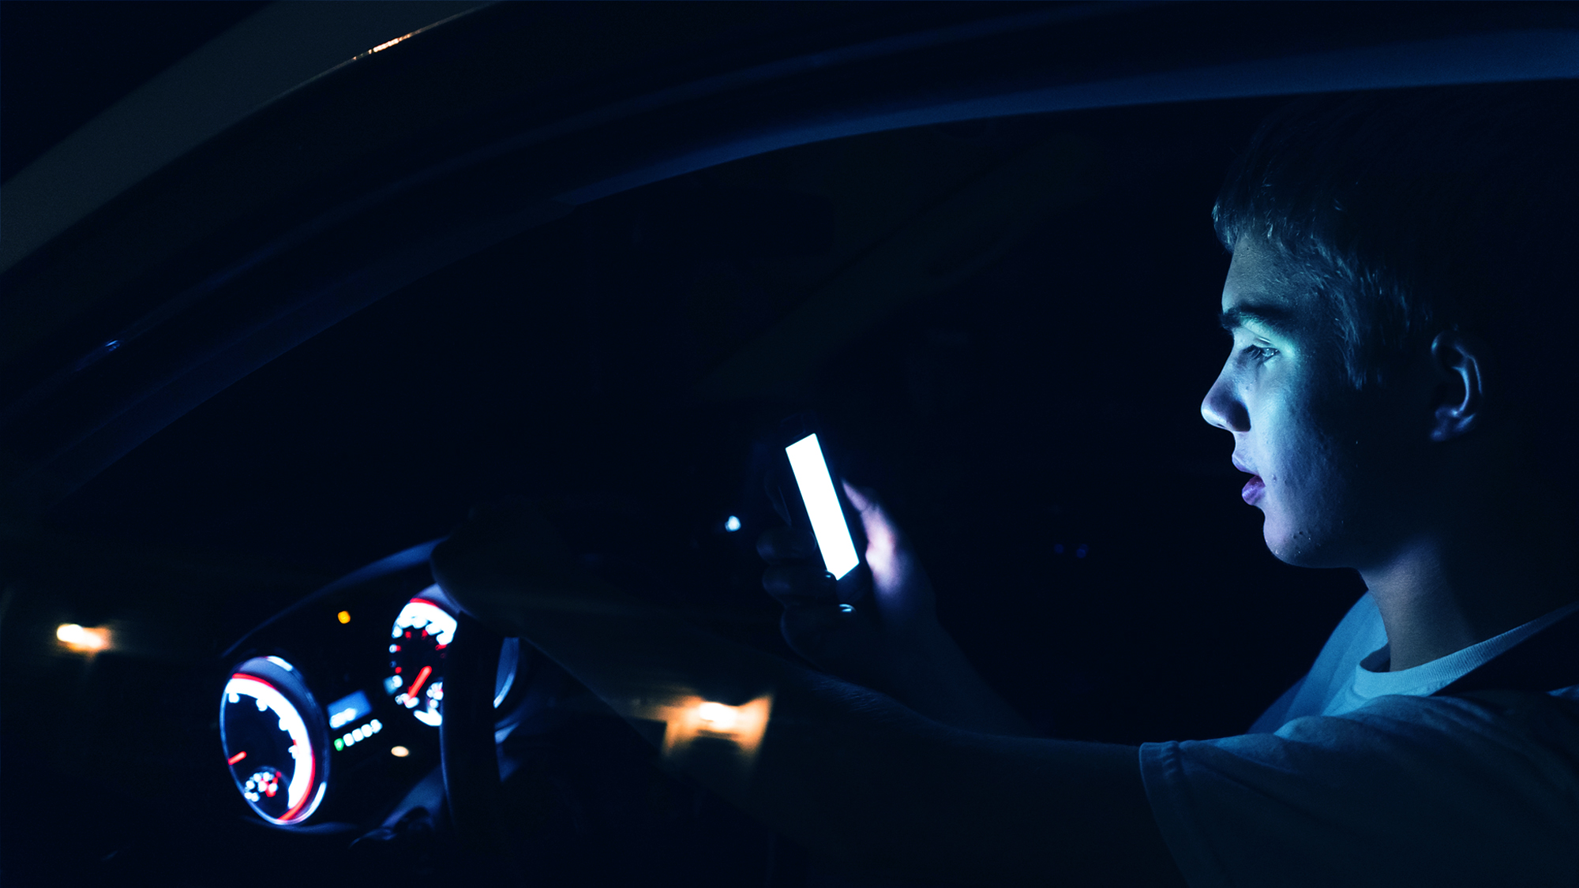
Distracted driving is any non-driving activity a person engages in that has the potential to distract them from the primary task of driving and increases the risk of crashing.
4
Notes:
In short -- A condition or state of mind in which the attention is diverted from an original focus or interest.
The National Safety Council reports that cell phone use while driving leads to 1.6 million crashes each year. Nearly 390,000 injuries occur each year from crashes caused by texting while driving.
1 out of every 4 car crashes in the United States is caused by texting and driving.

Slide 5





Not Another Gadget!
5 Stages of Behavior
Pre-contemplation
Contemplation
Preparation
Action
Maintenance
5
Notes:
(Your goal as the presenter is to encourage changed behavior. )
Being a focused driver requires behavioral change and there are 5 stages to make that change.
Pre-contemplation is the stage at which there is no intention to change behavior in the foreseeable future. Many individuals in this stage are unaware or under-aware of their problems. Contemplation is the stage in which people are aware that a problem exists and are seriously thinking about overcoming it but have not yet made a commitment to take action. Preparation is a stage that combines intention and behavioral criteria. Action is the stage in which individuals modify their behavior, experiences, or environment in order to overcome their problems. Action involves the most obvious behavioral changes and requires considerable commitment of time and energy. Maintenance is the stage in which people work to prevent relapse and consolidate the gains attained during action.

Slide 6
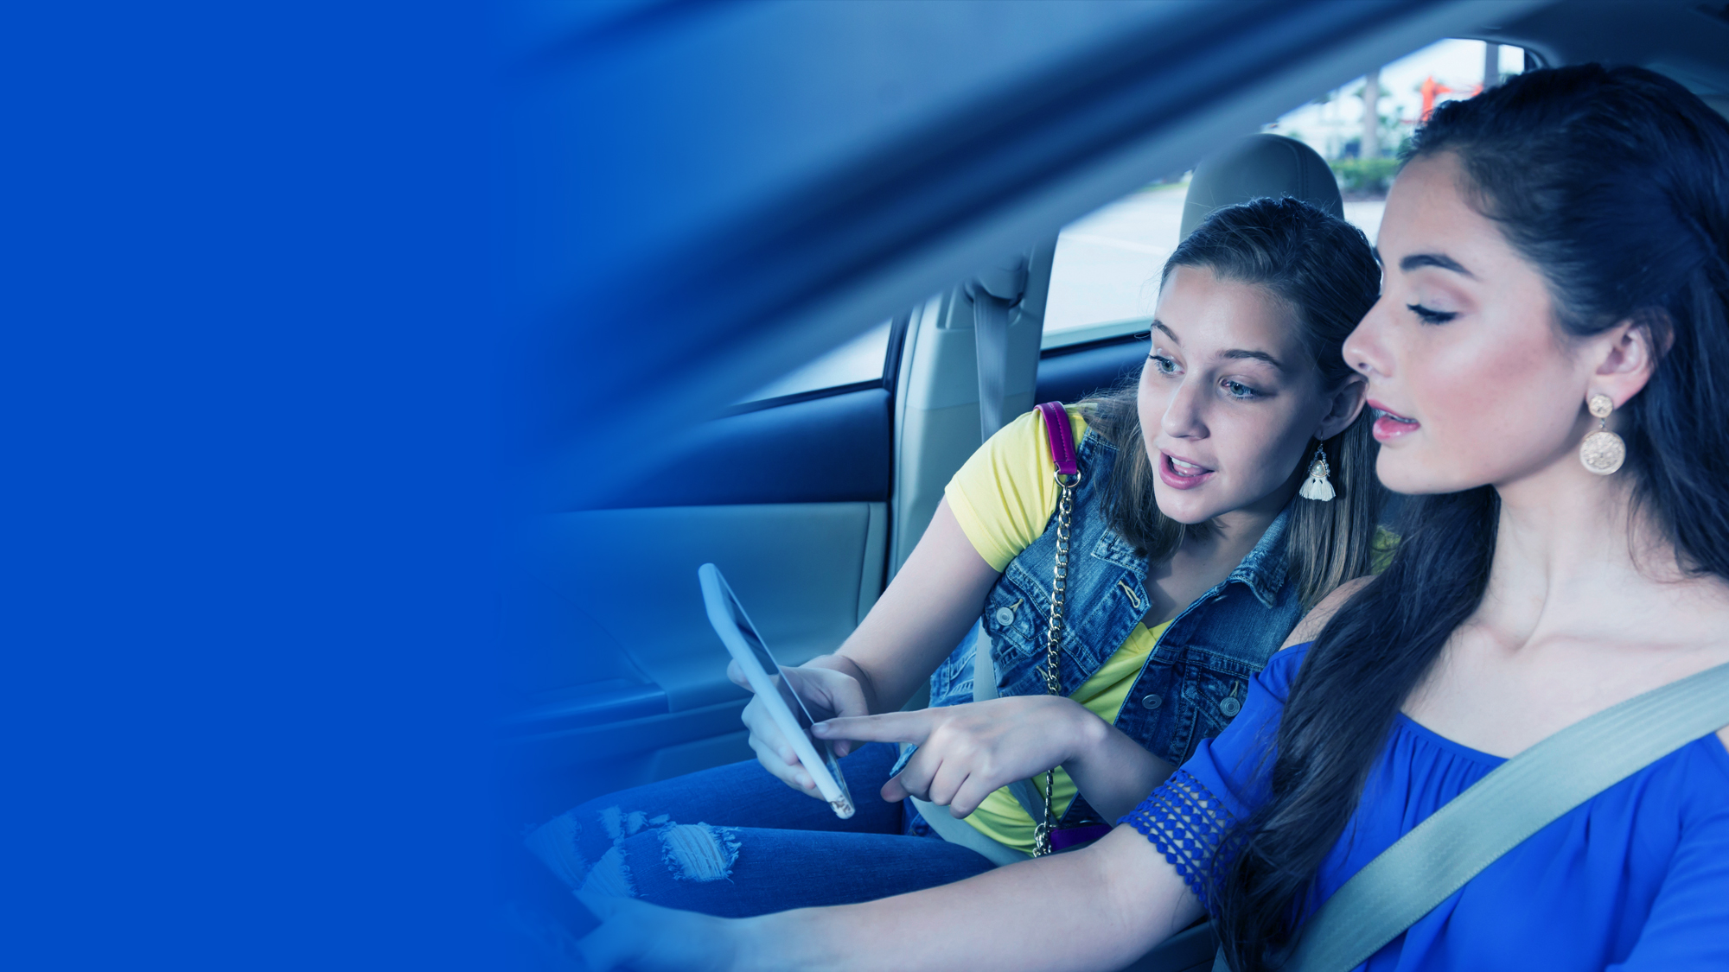
4-Types
Of Driving
Distractions
Visual
Manual
Cognitive
Auditory
6
Notes:
There are four categories of distracted driving:
Visual = Anything that will take your eyes off the road
Manual = Anything that will take your hands off the wheel
Cognitive = Anything that will take your mind off the task of driving
Auditory = Hearing/listening to something not related to driving (*updated report from GHSA and State Farm 7/2011)

Slide 7

Visual
7
Notes:
Ask the audience to talk about things done in the car that take our eyes off the road. When taking your eyes off the road for 5-seconds, traveling at a 55mph speed limit, you have traveled the length of a football field.

Slide 8
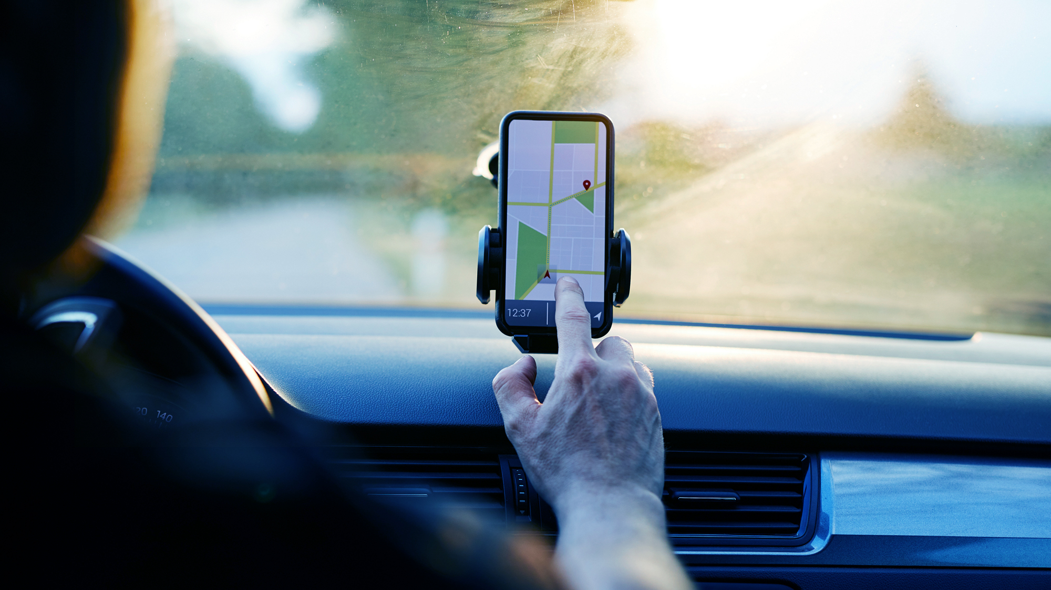
8
Notes:
Technology, although it can be useful, if not used appropriately can be a huge distraction. Gadgets may not always work or some my be re-routed or need to “calibrate.” When these things happen what do you do? This is why behavior is more important than the latest technology.

Slide 9


Tyler Presnell’s Story
9
Notes:
Running Time: 4:24
After showing Tyler’s story, revisit the 4 categories of distracted driving and ask how many types of distraction did the audience find in Tyler’s story. A great part of the distraction from Tyler’s incident was due to the driver talking to the other people in the car and taking his eyes off the road. Other violations such as speeding was very significant as well.

Slide 10

Manual
10
Notes:
Discuss things that are done in the car that take your hands off the wheel.

Slide 11
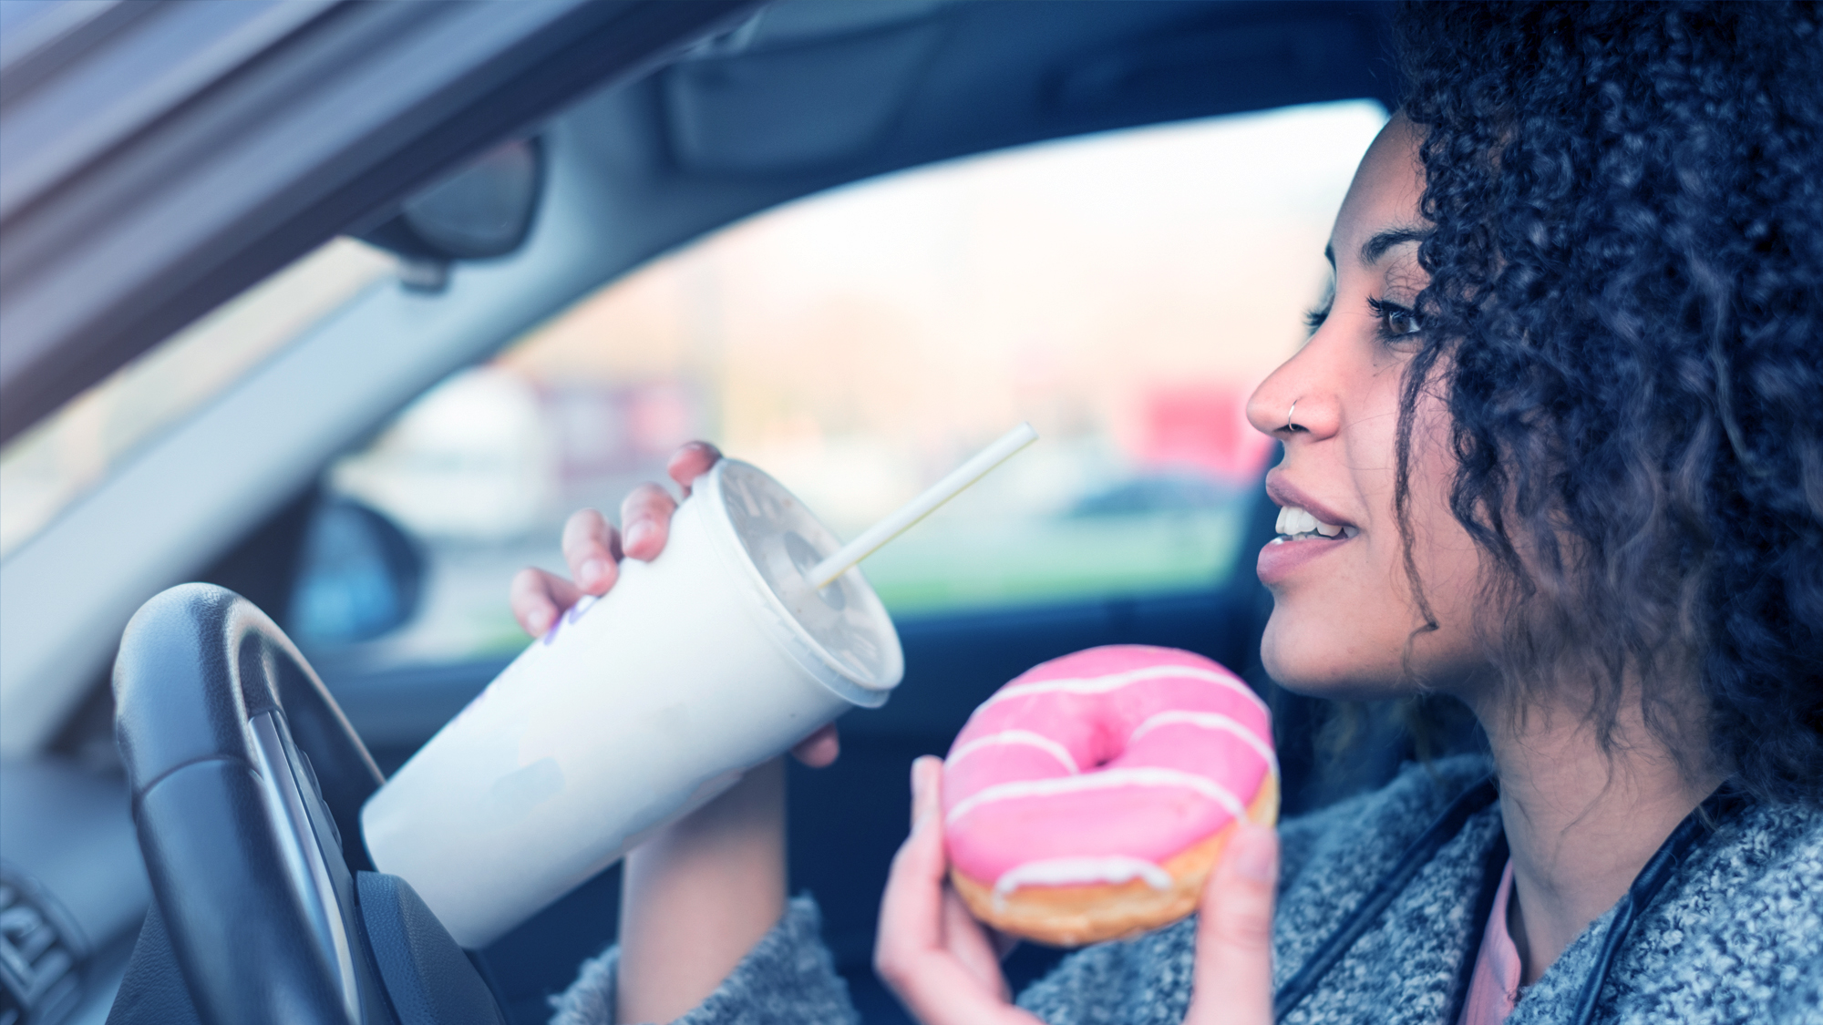
11
Notes:
Remind your audience to plan ahead and to make all adjustments before driving, do not eat or drink. Driving should be a totally focused task.

Slide 12

Ashley’s Story
Ashley’s Story
12
Notes:
Running Time: 3:48
Show Ashley’s story and discuss with your audience how she took her hands off the wheel and what she could have done to avoid such a tragedy.

Slide 13

Cognitive
13
Notes:
Discuss cognitive issues that are distracting while driving.

Slide 14

Sense of touch, differentiation in size, shape, color
Judgment
Problem solving
Planning
Personality
Attention
Speaking
Parietal Lobe
Frontal Lobe
Vision
Occipital Lobe
Memory
Hearing
Organizing
Balance Coordination
Temporal Lobe
Cerebellum
Spinal Cord
Consciousness
Heart rate
14
Notes:
People can only do one task effectively at a time. If you multi-task you are not paying full attention to any one task. Driving requires your full attention.
The brain is not fully developed until your mid twenties. If in a crash and you hit your head, one area or more from the graph above will be effected.

Slide 15
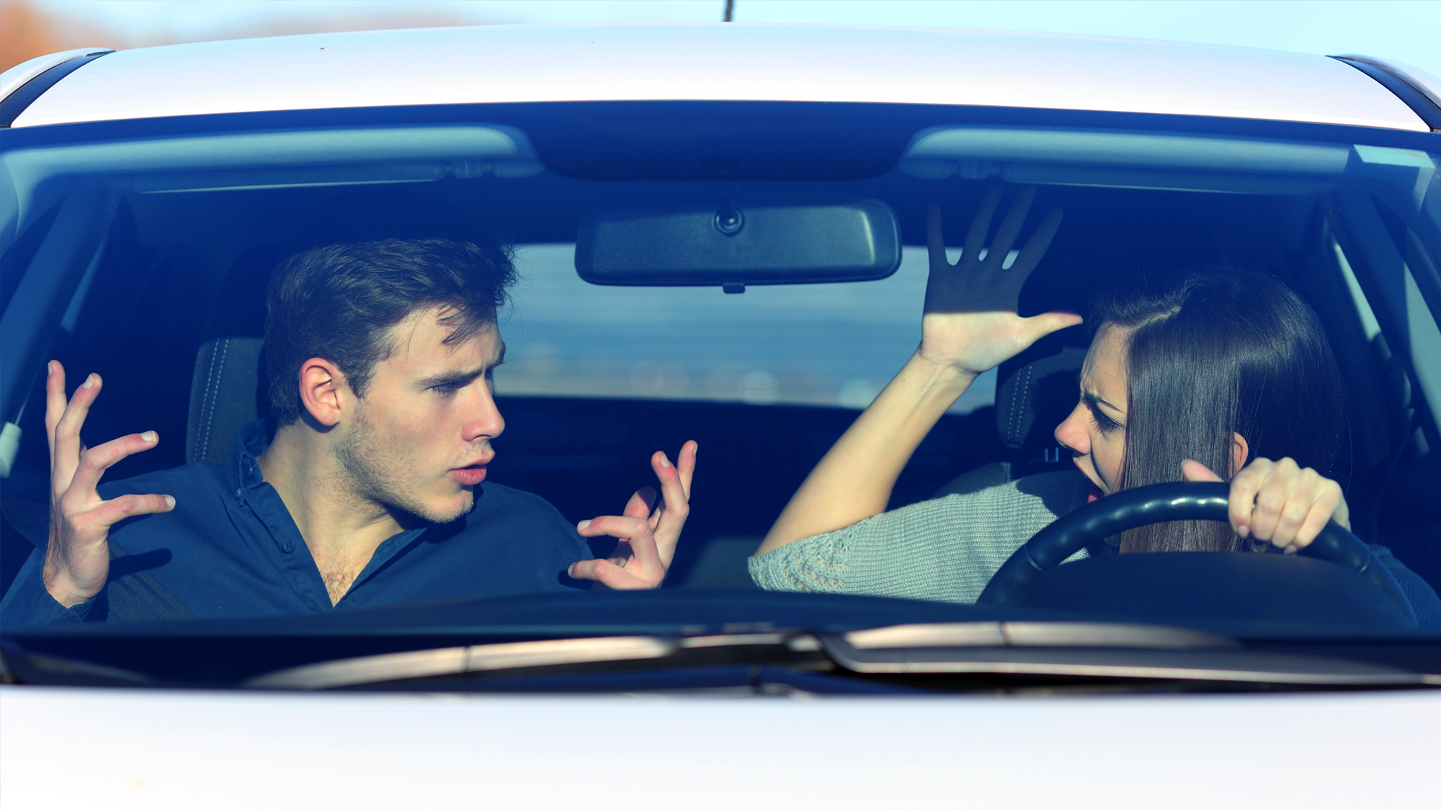



Engaged Conversation
Overjoyed Anger Sadness
Notes:
When in an engaged conversation, cognitive ability can be distorted. If you or passengers are in conversation, you become distracted.
Keep conversations, especially intense ones, minimal.
Emotions can cause the adrenaline to race, which can lead to destructive results.
Quick reactions are as bad as slow reactions while driving on the road. You want to maintain balanced behavior while driving.

Slide 16

Auditory
16
Notes:
Discuss things that you listen to or hear that causes distraction while driving.

Slide 17
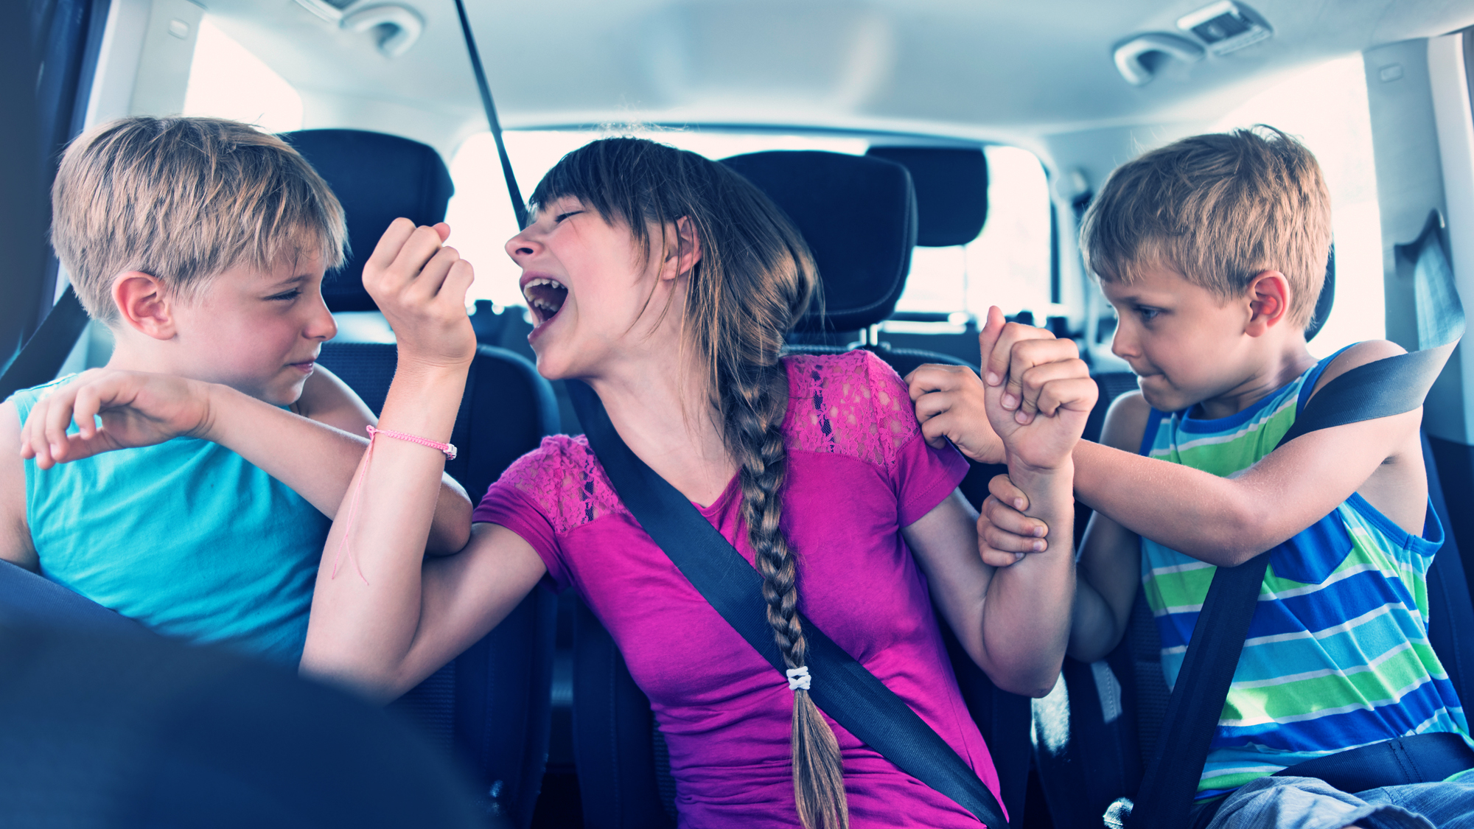
17
Notes:
Loud music, listening to an I-pod and even screaming children can be very distracting. Adjust station or listening music devices before driving and keep at a minimal sound. Give children quiet engaging things to do while in the car especially if on a long drive.

Slide 18
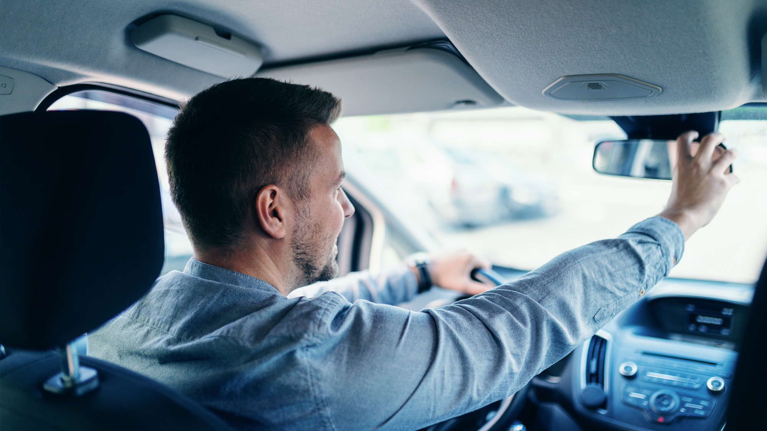
Pre-Driving Tips
Plan ahead
Turn off the phone
Make adjustments to seat, mirrors, etc.
Designate a rider (this means to have a person to ride with you that will answer your phone or your text messages.)
Get educated
18
Notes:
Plan ahead
Turn off the phone
Make adjustments to seat, mirrors, etc.
Designate a rider (this means to have a person to ride with you that will answer your phone or your text messages.)
Get educated

Slide 19

How can I make
a difference?
19
Notes:
Discuss with your audience how they can make a difference in their own behavior and in their community.

Slide 20
Pledge
20
Notes:
Running Time: 3:35

Slide 21

Educate Yourself
NHTSA.gov
Distraction.gov
AAAfoundation.org
NSC.org
GHSA.org
21
Notes:
The above websites are filled with information on distracted driving and other safe driving information.

Slide 22

In conclusion…
Keep Your Eyes
on the road
Hands
on the wheel
Mind
on driving
22

Slide 23
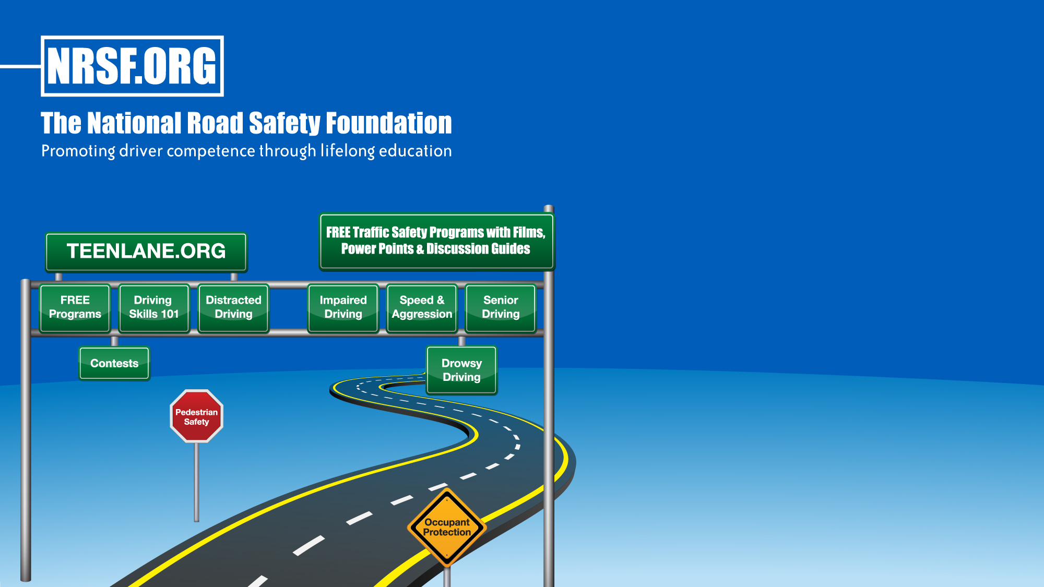




Free Safe Driving Resources
18 East 50th Street
New York, NY 10022
866-SAFEPATH (723-3728)
info@nrsf.org
www.nrsf.org • www.teenlane.org
@NRSForg
@NRSForg
@NRSForg
nationalroadsafety

